Slide 1
The Kitchen Kalculator
Mallary Gilmore and Robert Vancleave

Slide 2
Target Devices:
Laptop
Home Computers

Slide 3
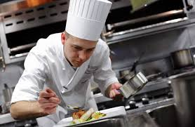

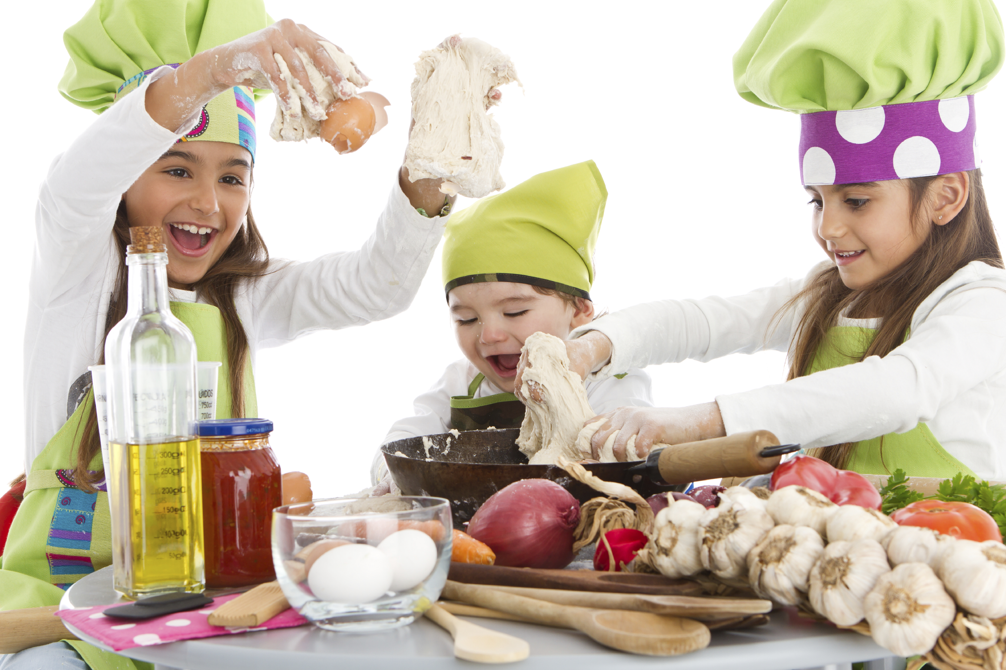
Target Audience:
Anyone that cooks.

Slide 4
Purpose:
There is nothing more frustrating than trying to follow a recipe and having to stop to GOOGLE conversions, because let’s face it, none of us remember all of the conversions we learned in school! This program is designed to aid in recipe conversions at your convenience with ease.

Slide 5

Test Plan
To test our program, we gave it to a few web-based programming forums on facebook, reddit, and the like. We were pleased to see our program run and meet our expectations!
They were indifferent to it.

Slide 6
Our Biggest Challenge:
Error checking—countless accounts of minute details creating an avalanche of compounding run errors.
Operator error—losing hours of progress multiple times in a row due to failure to save said progress in compiler.
Loss of Manpower—We lost the equivalent of a hundred percent of our current group size.

Slide 7
Refactoring
We refactored our code by condensing statements into functions. We also added more error failsafes, solidified our if statements into switch statements, and clarified instruction for the user.

Slide 8
Execution
The introduction screen will welcome you to the program.
The home screen will then ask what you are converting from and to; simply input your selection by choosing the appropriate number.
The program will then ask for the numerical value of what we will be converting.
The program will then convert your measurements and ask if you would like to convert something else!
Execution complete ☺

Slide 9
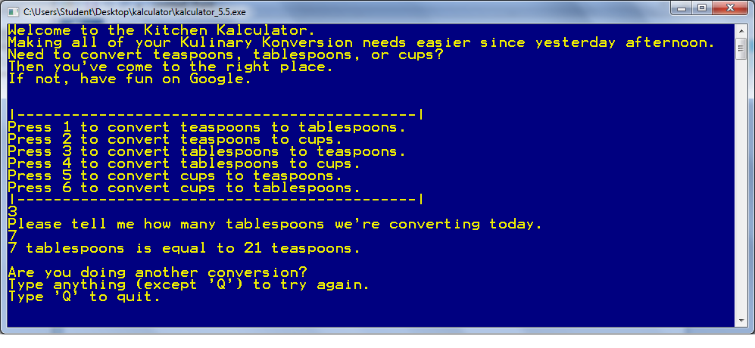
Take a look….

